Slide 1
AI Accounting
$
Assistant Agent
(n8n)
SCTP Agentic AI Capstone
Presented by Sylvester Ang
n8n · Groq LLM · PDF Extractor · Google Sheets

Slide 2
Project Objective
Business Value
Eliminates manual data entry errors
Automate extraction of financial data from bank statements using AI and n8n workflows — transforming manual bookkeeping into intelligent, streamlined operations for SMEs.
Processes statements in seconds
Generates structured P&L data
Ingest
Extract
Structure
Scales across multiple clients
PDF bank statements
AI financial parsing
JSON → Sheets
2

Slide 3
What the Agent Does
Agent
Capabilities
01
02
Accept
Extract
PDF bank statement via webhook
Text parsed from PDF document
1. Webhook Trigger
2. PDF Text Extract
03
04
Identify
Structure
3. Groq AI Parse
AI extracts financial data fields
Converts to organised JSON format
4. JSON Structure
05
06
Store
Report
5. Sheets Upload
Saves to Google Sheets automatically
P&L statement ready for review
6. P&L Output
3

Slide 4
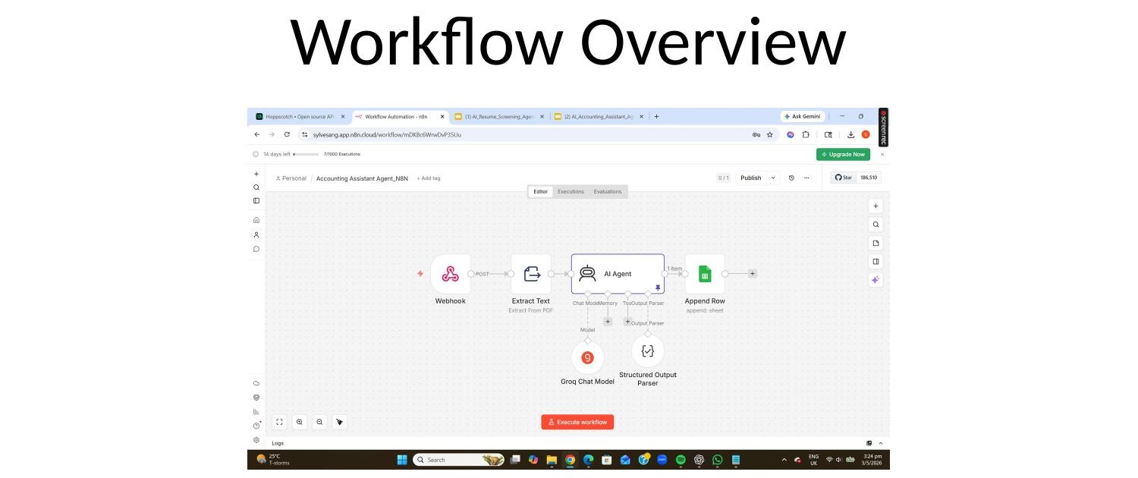
Workflow Overview
Flow Summary
Webhook receives PDF bank statement
Text extracted from PDF document
Groq LLM identifies financial fields
Data structured into clean JSON
JSON written to Google Sheets
Webhook → Extract Text → AI Agent → Append Row (Google Sheets)
4

Slide 5
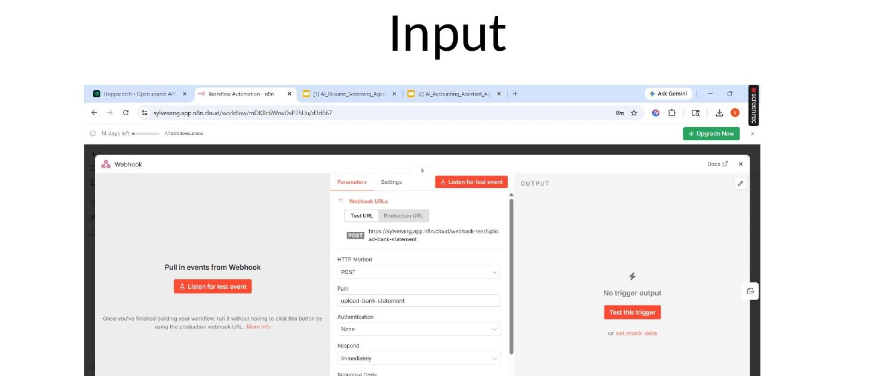
Input
Input Details
PDF bank statement (binary data)
Sent via HTTP POST to n8n webhook
Webhook URL: /upload-bank-statement
Triggers the full extraction pipeline
No manual file handling required
Webhook listens for PDF bank statement upload via POST request
5

Slide 6
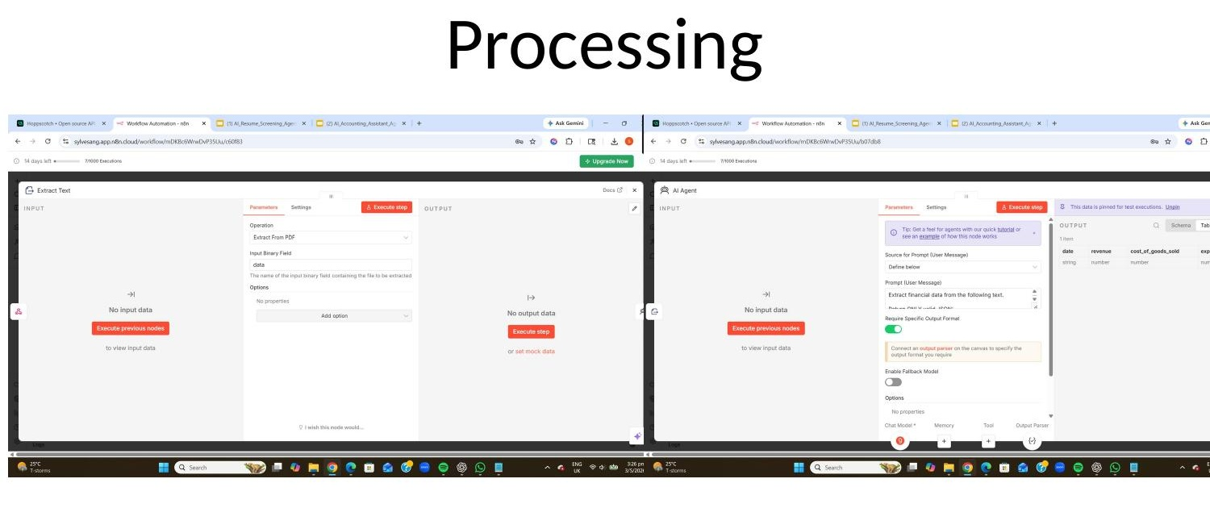
Processing
Processing Steps
Extract Text node reads PDF binary
Outputs raw text from bank statement
AI Agent receives extracted text
Groq LLM identifies financial fields
Structured Output Parser formats JSON
Extract Text node → AI Agent node — PDF → Text → Structured JSON
6

Slide 7
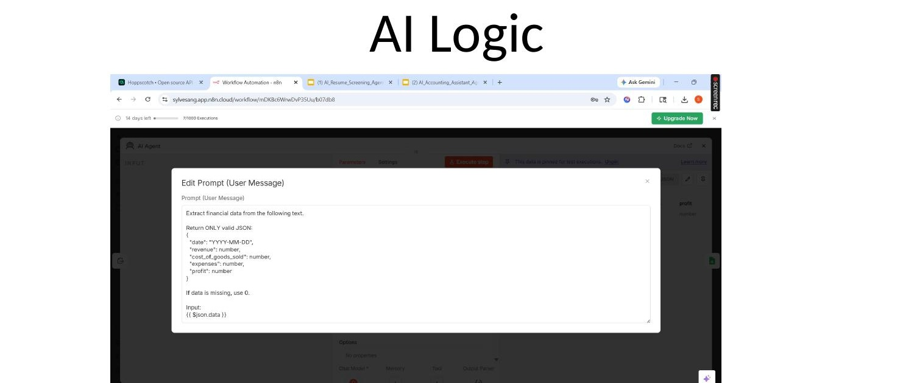
AI Logic & Output Structure
Prompt Design
Extract financial data from text
Return ONLY valid JSON format
5 specific field names enforced
Missing values default to 0
{ "date":"YYYY-MM-DD", "revenue":number, "cost_of_goods_sold":number, "expenses":number, "profit":number }
Groq Chat Model + Structured Parser
7

Slide 8
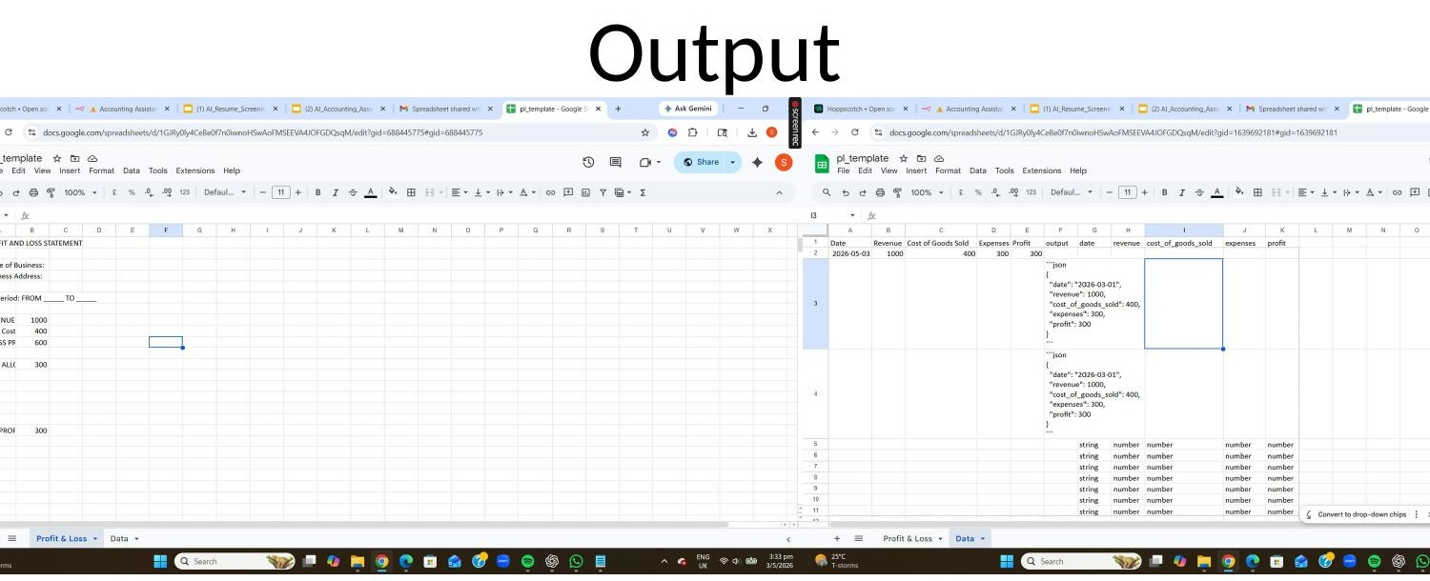
Output
Output Details
Date, Revenue, COGS, Expenses, Profit
Appended as new row in Google Sheets
Profit & Loss tab updated automatically
Raw JSON also stored in Data tab
Financial data automatically stored in Google Sheets P&L statement
Audit-ready structured records
90%
0
Less manual entry time
Transcription errors
8

Slide 9
Tools Used
Tech Stack
Four tools working together to automate the full financial data pipeline from raw PDF to structured Sheets.
n8n
Groq / LLM
Workflow Orchestration Engine
AI Financial Data Extraction
4
Tools
Integrated
PDF Extractor
Google Sheets API
Bank Statement Text Parsing
Structured Financial Storage
9

Slide 10
Challenges & Solutions
Key Learnings
⚠ Challenge
✓ Solution
Prompt engineering is critical for data extraction
Unstructured PDF
JSON Parser
Bank statements have inconsistent layouts, making text extraction unreliable
Strict AI prompt forces structured JSON output regardless of input format
Structured output saves downstream processing
Real-world PDFs require defensive parsing
⚠ Challenge
✓ Solution
Data Inconsistency
Strict AI Prompt
Modular design simplifies future updates
Financial fields named differently across various bank statement formats
Prompt defines exact field names and types — AI normalises all variations
10

Slide 11
Conclusion
AI automation improves efficiency & accuracy in financial workflows
💰 Turns manual bookkeeping into automated intelligence
📊 Consistent JSON structure enables reliable P&L reports
⚡ n8n orchestrates the full PDF-to-Sheets pipeline
🎯 Strict AI prompting ensures financial data accuracy
SCTP Agentic AI Capstone · Sylvester Ang

